Slide 1
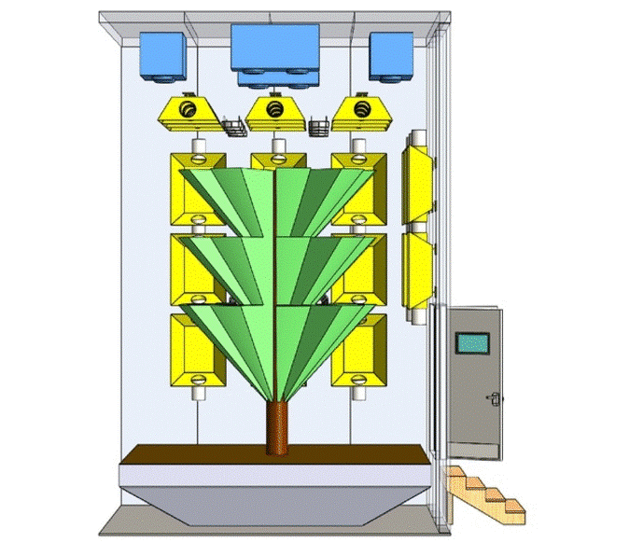

Slide 2
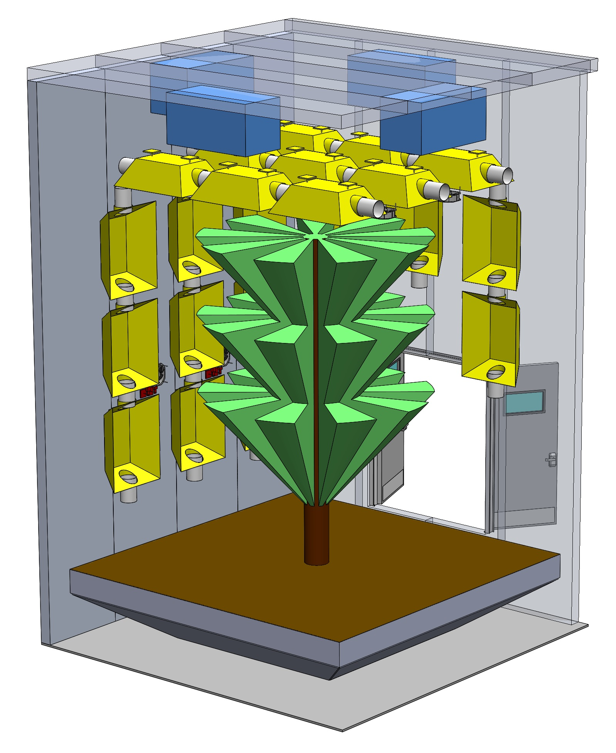
External Width: 229cm
Tree-to-Light
Distance: 60cm
External Height: 716cm
Tree-to-Light
Distance: 46cm
Door: 214cm Height
by 184cm Wide
Soil Tray Depth: 91cm Wide
Tree Height: 411cm
Tree Diameter: 290cm
Soil Tray Width: 430cm

Slide 3
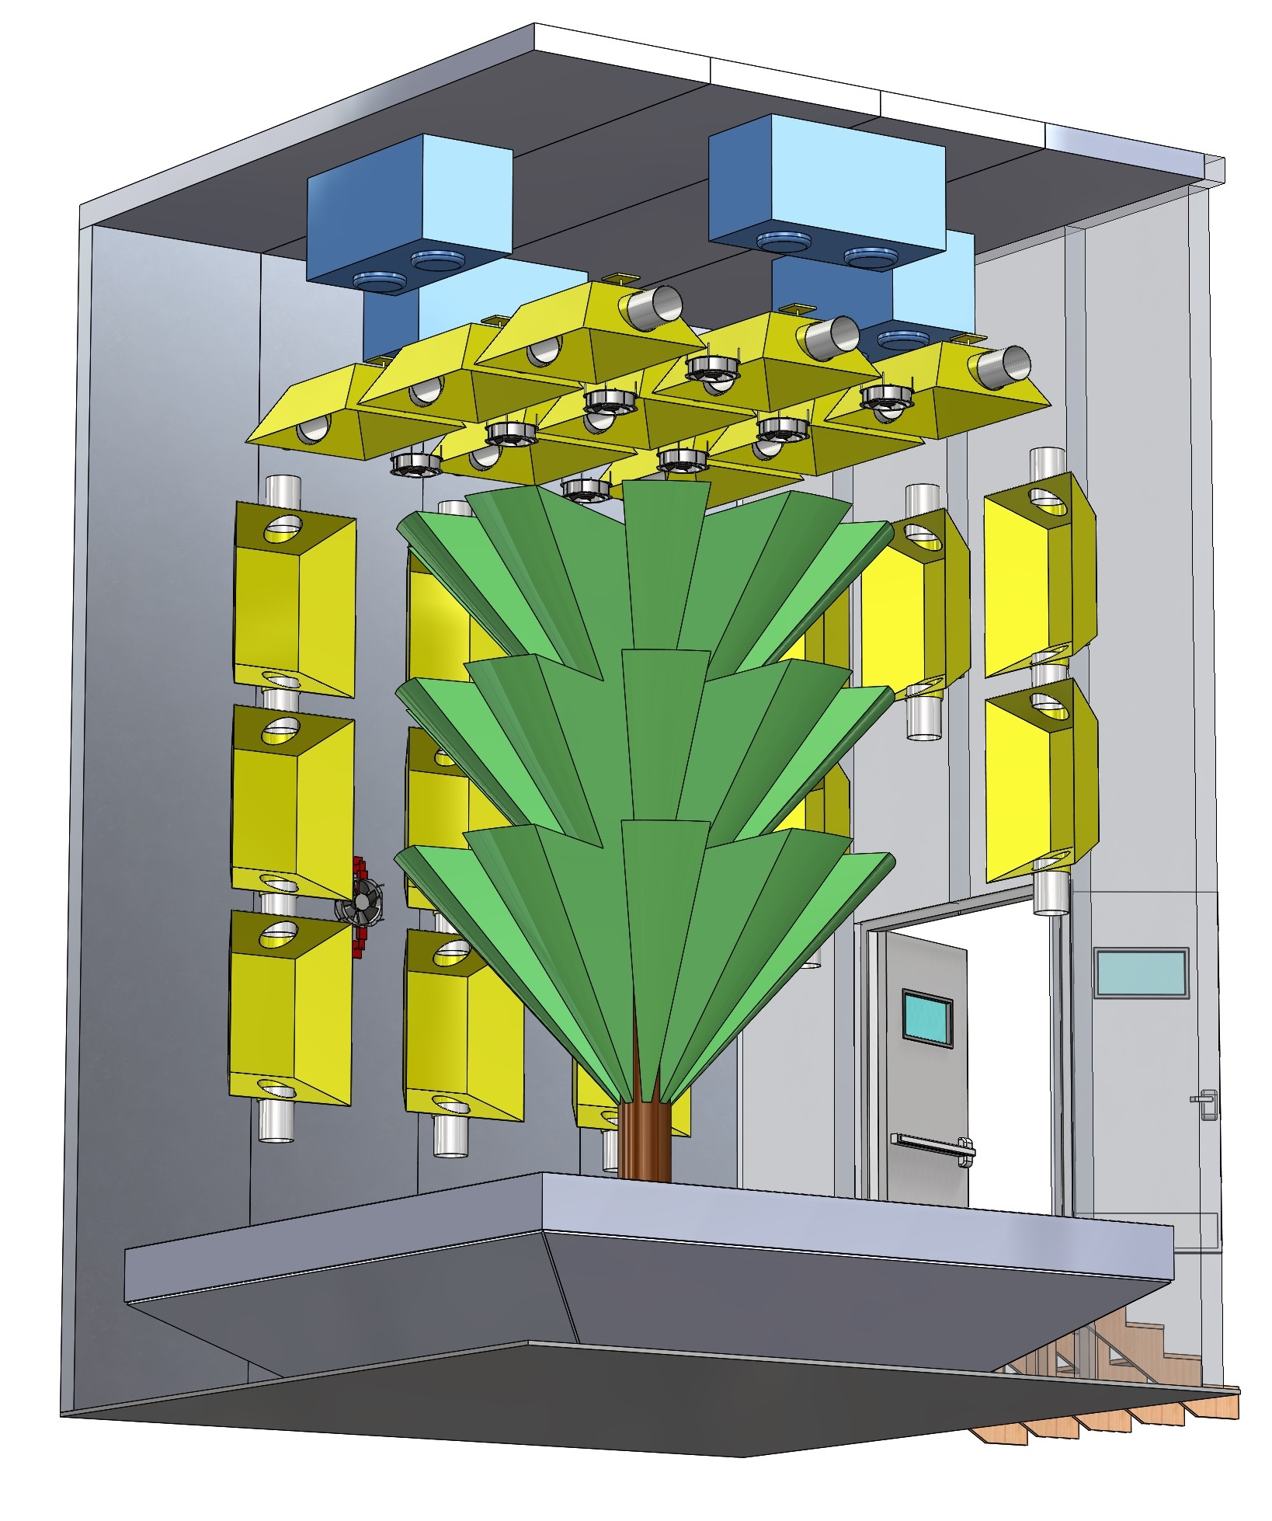
External Width: 229cm
Tree-to-Light
Distance: 60cm
Tree-to-Light
Distance: 46cm
External Height: 716cm
Tree Diameter: 290cm
Door: 214cm Height
by 184cm Wide
Soil Tray Depth: 91cm Wide
Soil Tray Width: 430cm
Tree Height: 411cm

Slide 4
